Slide 1
Electric Field and Electric Potential
CSPC 132
MR. MARK OFORI NKETIA

Slide 2
Energy Considerations
When a force, F, acts on a particle, work is done on the particle in moving from point a to point b
If the force is a conservative, then the work done can be
expressed in terms of a change in potential energy
Also if the force is conservative, the total energy of the
particle remains constant

Slide 3
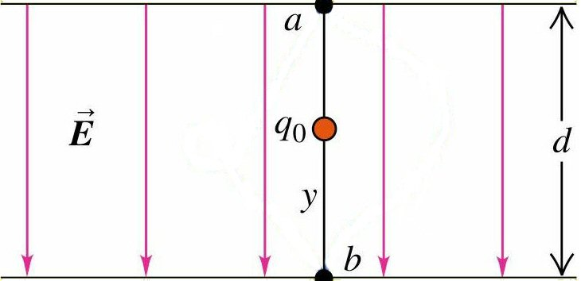
Work Done by Uniform Electric Field
Force on charge is
Work is done on the
charge by field
The work done is independent of path taken from point a to point b because
The Electric Force is a conservative force

Slide 4
Electric Potential Energy
The work done by the force is the same as the change in the particle’s potential energy
The work done only depends upon the change in position

Slide 5
Electric Potential Energy
General Points
1) Potential Energy increases if the particle moves in the direction opposite to the force on it
Work will have to be done by an external agent for this to occur
and
2) Potential Energy decreases if the particle moves in the same direction as the force on it

Slide 6
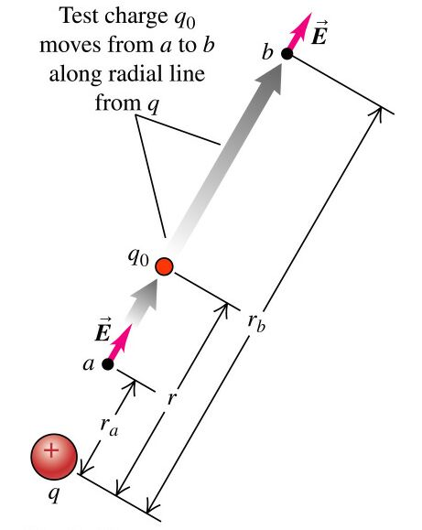
Potential Energy of Two Point Charges
Suppose we have two charges q and q₀ separated by a distance r
The force between the two charges is given by Coulomb’s Law
We now displace charge q₀ along a radial line from point a to point b
The force is not constant during this displacement

Slide 7
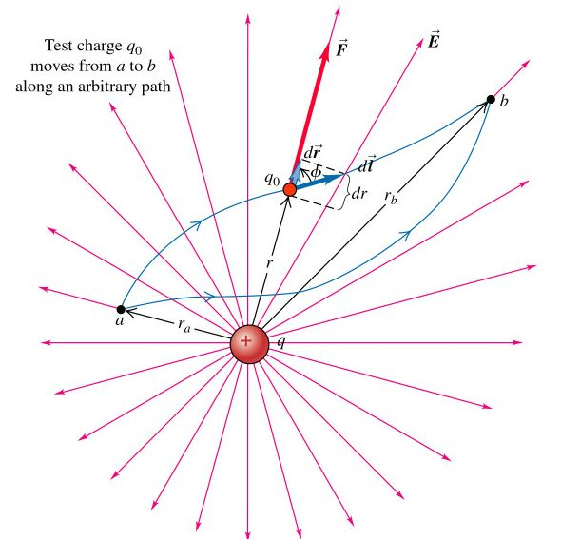
Potential Energy of Two Point Charges
The work done is not dependent upon the path taken in getting from point a to point b
The work done is related to the component of the force along the displacement

Slide 8
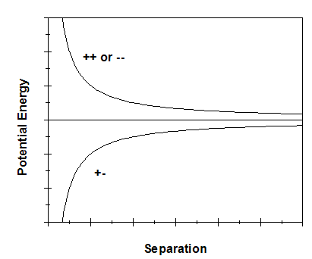
Potential Energy
Looking at the work done we notice that there is the same functional at points a and b and that we are taking the difference
We define this functional to be the potential energy
The signs of the charges are included in the calculation
The potential energy is taken to be zero when the two charges are infinitely separated

Slide 9
A System of Point Charges
Suppose we have more than two charges
Have to be careful of the question being asked
Two possible questions:
1) Total Potential energy of one of the charges with respect to remaining charges
or
2) Total Potential Energy of the System

Slide 10
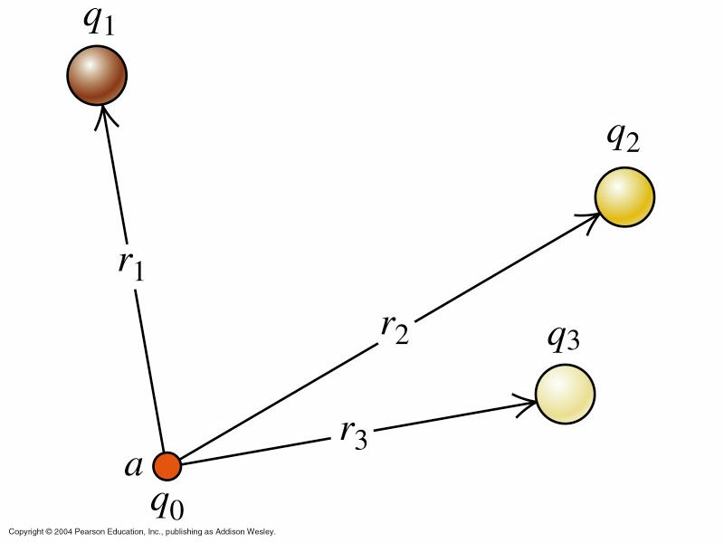
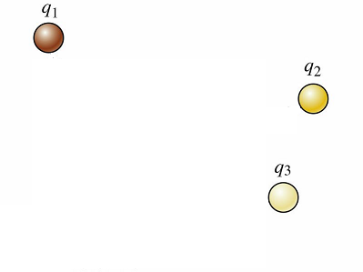
Case 1: Potential Energy of one charge with respect to others
Given several charges, q₁…q_{n}, in place
Now a test charge, q₀, is brought into position
Work must be done against the electric fields of the original charges
This work goes into the potential energy of q₀
We calculate the potential energy of q₀ with respect to each of the other charges and then
Just sum the individual potential energies
Remember - Potential Energy is a Scalar

Slide 11
Case 2: Potential Energy of a System of Charges
Start by putting first charge in position
No work is necessary to do this
Next bring second charge into place
Now work is done by the electric field of the first charge. This work goes into the potential energy between these two charges.
Now the third charge is put into place
Work is done by the electric fields of the two previous charges. There are two potential energy terms for this step.
We continue in this manner until all the charges are in place
The total potential is then given by

Slide 12
Example 1
Two test charges are brought separately to the vicinity of a positive charge Q
Q
r
Charge +q is brought to pt A, a distance r from Q
q
A
Charge +2q is brought to pt B, a distance 2r from Q
Q
B
2r
2q
I) Compare the potential energy of q (U_{A}) to that of 2q (U_{B})
(a) U_{A} < U_{B}
(b) U_{A} = U_{B}
(c) U_{A} > U_{B}
II) Suppose charge 2q has mass m and is released from rest from the above position (a distance 2r from Q). What is its velocity v_{f} as it approaches r = ∞ ?
(a)
(b)
(c)

Slide 13
Example 2
Two test charges are brought separately to the vicinity of a positive charge Q
Q
r
Charge +q is brought to pt A, a distance r from Q
q
A
Charge +2q is brought to pt B, a distance 2r from Q
Q
B
2r
2q
I) Compare the potential energy of q (U_{A}) to that of 2q (U_{B})
(a) U_{A} < U_{B}
(b) U_{A} = U_{B}
(c) U_{A} > U_{B}
The potential energy of q is proportional to Qq/r
The potential energy of 2q is proportional to Q(2q)/(2r) = Qq/r
Therefore, the potential energies U_{A} and U_{B} are EQUAL!!!

Slide 14
Example 3
II) Suppose charge 2q has mass m and is released from rest from the above position (a distance 2r from Q). What is its velocity v_{f} as it approaches r = ∞ ?
(a)
(b)
(c)
The principle at work here is CONSERVATION OF ENERGY.
Initially:
The charge has no kinetic energy since it is at rest.
The charge does have potential energy (electric) = U_{B}.
Finally:
The charge has no potential energy (U ∝ 1/R)
The charge does have kinetic energy = KE

Slide 15

Electric Potential
Recall Case 1 from before
The potential energy of the test charge, q₀, was given by
Notice that there is a part of this equation that would remain the same regardless of the test charge, q₀, placed at point a
The value of the test charge can be pulled out from the summation

Slide 16
Electric Potential
We define the term to the right of the summation as the electric potential at point a
Like energy, potential is a scalar
We define the potential of a given point charge as being
This equation has the convention that the potential is zero at infinite distance

Slide 17
Electric Potential
The potential at a given point
Represents the potential energy that a positive unit charge would have, if it were placed at that point
It has units of

Slide 18
Electric Potential
General Points for either positive or negative charges
The Potential increases if you move in the direction opposite to the electric field
and
The Potential decreases if you move in the same direction as the electric field

Slide 19
Example 4
A
Points A, B, and C lie in a uniform electric field.
E
C
B
What is the potential difference between points A and B?
ΔV_{AB} = V_{B} - V_{A}
a) ΔV_{AB} > 0 b) ΔV_{AB} = 0 c) ΔV_{AB} < 0
The electric field, E, points in the direction of decreasing potential
Since points A and B are in the same relative horizontal location in the electric field there is on potential difference between them

Slide 20
Example 5
A
Points A, B, and C lie in a uniform electric field.
E
C
B
Point C is at a higher potential than point A.
True False
As stated previously the electric field points in the direction of decreasing potential
Since point C is further to the right in the electric field and the electric field is pointing to the right, point C is at a lower potential
The statement is therefore false

Slide 21
Example 6
A
Points A, B, and C lie in a uniform electric field.
E
C
B
If a negative charge is moved from point A to point B, its electric potential energy
a) Increases. b) decreases. c) doesn’t change.
The potential energy of a charge at a location in an electric field is given by the product of the charge and the potential at the location
As shown in Example 4, the potential at points A and B are the same
Therefore the electric potential energy also doesn’t change

Slide 22
Example 7
A
Points A, B, and C lie in a uniform electric field.
E
C
B
Compare the potential differences between points A and C and points B and C.
a) V_{AC} > V_{BC} b) V_{AC} = V_{BC} c) V_{AC} < V_{BC}
In Example 4 we showed that the the potential at points A and B were the same
Therefore the potential difference between A and C and the potential difference between points B and C are the same
Also remember that potential and potential energy are scalars and directions do not come into play

Slide 23
Work and Potential
The work done by the electric force in moving a test charge from point a to point b is given by
Dividing through by the test charge q₀ we have
Rearranging so the order of the subscripts is the same on both sides

Slide 24
Potential
From this last result
We get
We see that the electric field points in the direction of decreasing potential
We are often more interested in potential differences as this relates directly to the work done in moving a charge from one point to another

Slide 25
Example 8
If you want to move in a region of electric field without changing your electric potential energy. You would move
Parallel to the electric field
Perpendicular to the electric field
The work done by the electric field when a charge moves from one point to another is given by
The way no work is done by the electric field is if the integration path is perpendicular to the electric field giving a zero for the dot product

Slide 26
Example 9
A positive charge is released from rest in a region of electric field. The charge moves:
a) towards a region of smaller electric potential
b) along a path of constant electric potential
c) towards a region of greater electric potential
A positive charge placed in an electric field will experience a force given by
But E is also given by
Therefore
Since q is positive, the force F points in the direction opposite to increasing potential or in the direction of decreasing potential

Slide 27
Units for Energy
There is an additional unit that is used for energy in addition to that of joules
A particle having the charge of e (1.6 x 10⁻¹⁹ C) that is moved through a potential difference of 1 Volt has an increase in energy that is given by

Slide 28
Equipotential Surfaces
It is possible to move a test charge from one point to another without having any net work done on the charge
This occurs when the beginning and end points have the same potential
It is possible to map out such points and a given set of points at the same potential form an equipotential surface

Slide 29
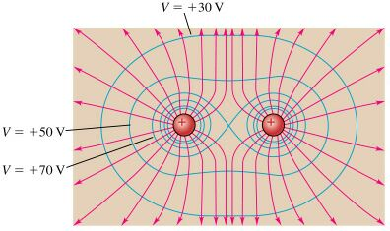
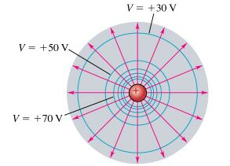
Equipotential Surfaces
Examples of equipotential surfaces
Point Charge
Two Positive Charges

Slide 30
Equipotential Surfaces
The electric field does no work as a charge is moved along an equipotential surface
Since no work is done, there is no force, qE, along the direction of motion
The electric field is perpendicular to the equipotential surface

Slide 31
What about Conductors
In a static situation, the surface of a conductor is an equipotential surface
But what is the potential inside the conductor if there is a surface charge?
We know that E = 0 inside the conductor
This leads to

Slide 32
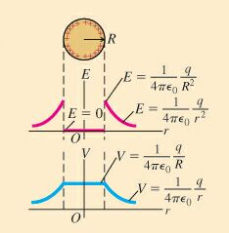
What about Conductors
The value of the potential inside the conductor is chosen to match that at the surface

Slide 33
Potential Gradient
The equation that relates the derivative of the potential to the electric field that we had before
can be expanded into three dimensions

Slide 34
Potential Gradient
For the gradient operator, use the one that is appropriate to the coordinate system that is being used.

Slide 35
Example 10
The electric potential in a region of space is given by
The x-component of the electric field E_{x} at x = 2 is
(a) E_{x} = 0 (b) E_{x} > 0 (c) E_{x} < 0
We know V(x) “everywhere”
To obtain E_{x} “everywhere”, use

Slide 36
THANK YOU

